Slide 1
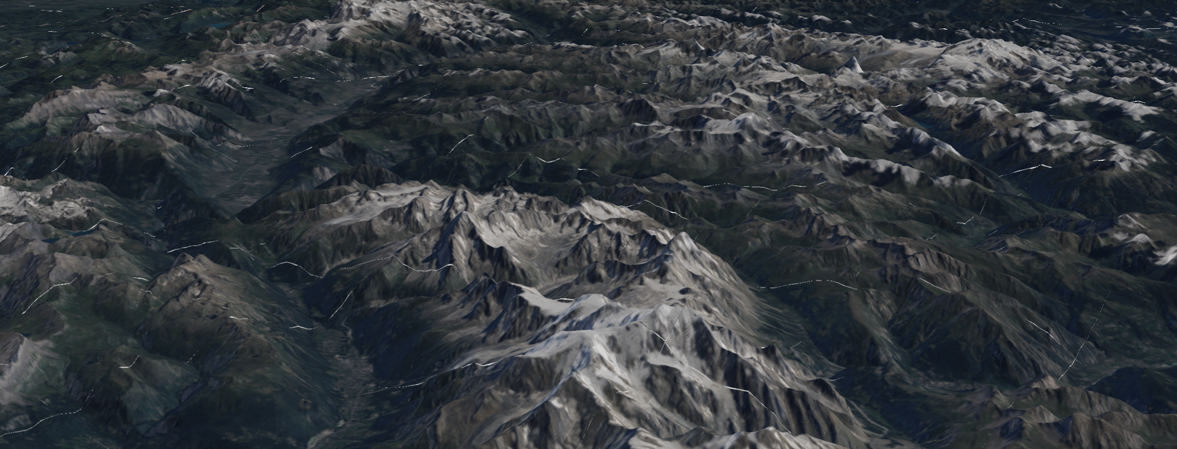

Leveraging Cloud-Optimized GeoTIFFs to Enable New Methods in Web Mapping
Kyle Barron
Notes:
I’ll give a quick overview of why I’m excited about COGs, followed by applications I’ve built with COGs, followed by more in depth details about working with COGs

Slide 2
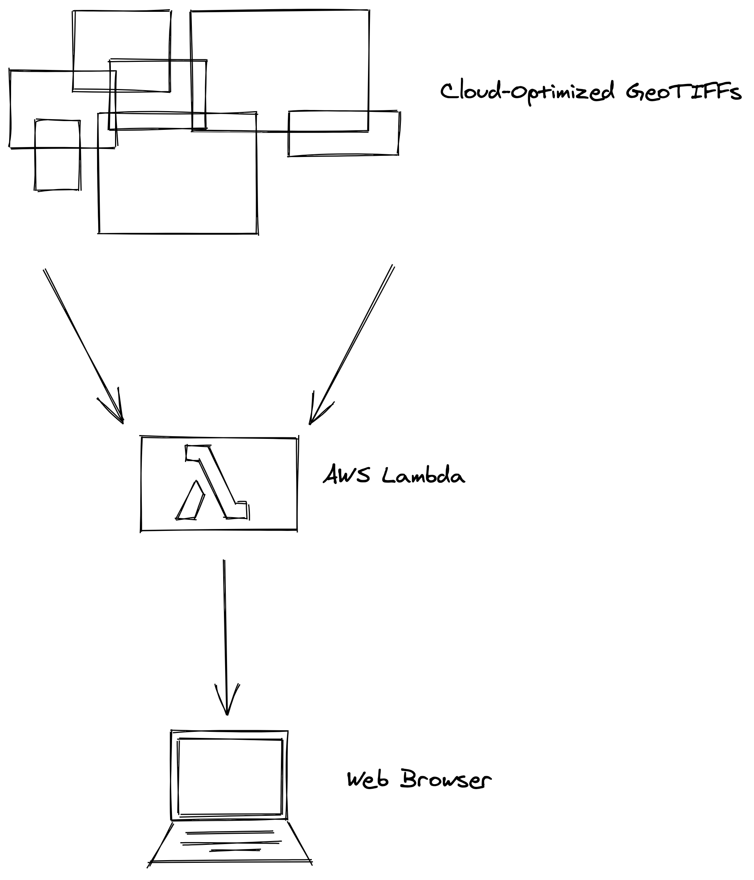
Why I’m excited about COG
Cloud-Optimized GeoTIFFs (COG) support efficient data streaming
Huge collections of data in COG public on S3
Browser is the future:
How to move data efficiently?
Request COG directly from browser?
Serverless in the middle: low-latency to S3; combine + reproject to Web Mercator
Notes:
Browser is ubiquitous
How to
My contributions:
Dynamic tiling of Mosaic. Most existing viewers are single-scene. Mosaic=seamless
WebGL: Bringing raw data into WebGL in the browser for performance.
Request COG directly from JS? Ok to visualize one image; too slow for collections of images; reprojection difficult

Slide 3
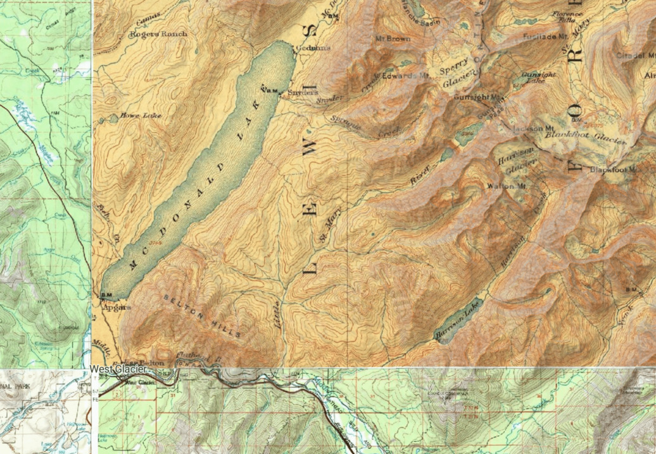
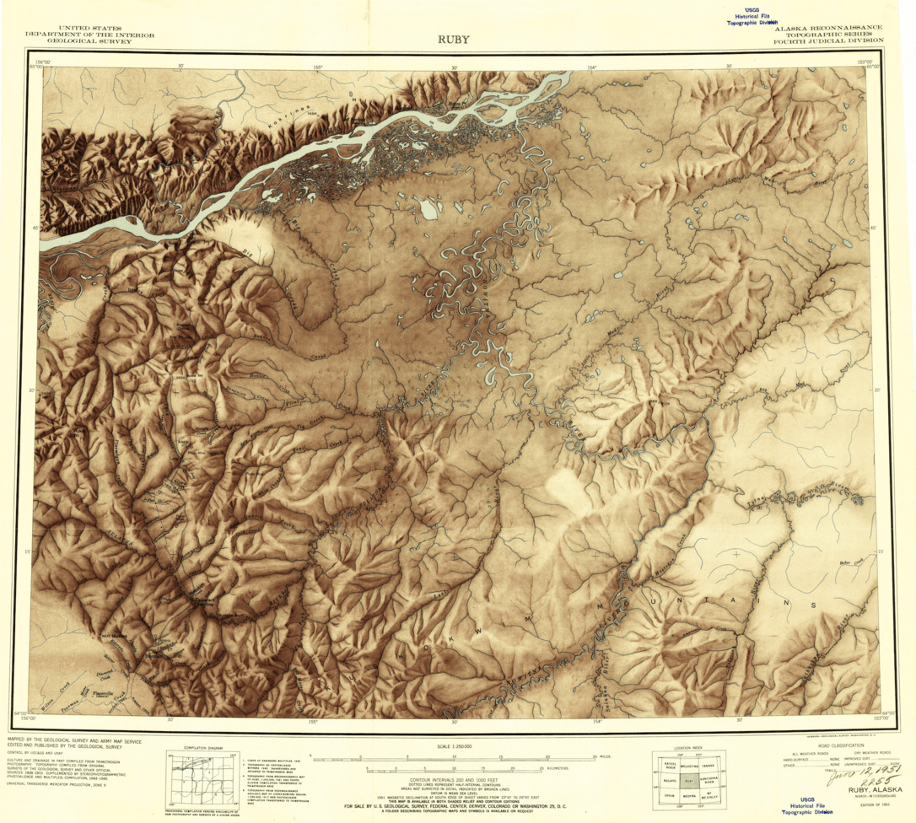

USGS Topo Maps
- 180,000 USGS Topographic Maps from 1884 to 2006 in COG format
- Remove map collar on the fly
https://github.com/kylebarron/usgs-topo-tiler
https://github.com/kylebarron/usgs-topo-mosaic
Live demo: https://kylebarron.dev/usgs-topo-mosaic

Slide 4
USGS Elevation Data
- USGS elevation data recently moved to COG
- Resolutions: from 2 arc-second to 1 meter
- Terrain mesh, hillshade, aspect map
https://github.com/kylebarron/dem-tiler (server)
https://github.com/kylebarron/pymartini (terrain mesh)
https://github.com/kylebarron/quantized-mesh-encoder (encode mesh)
Live demo: https://kylebarron.dev/quantized-mesh-encoder
(Uses AWS Terrain Tiles)
Notes:
Can use COG; I currently use AWS Terrain Tiles, an open dataset on AWS

Slide 5
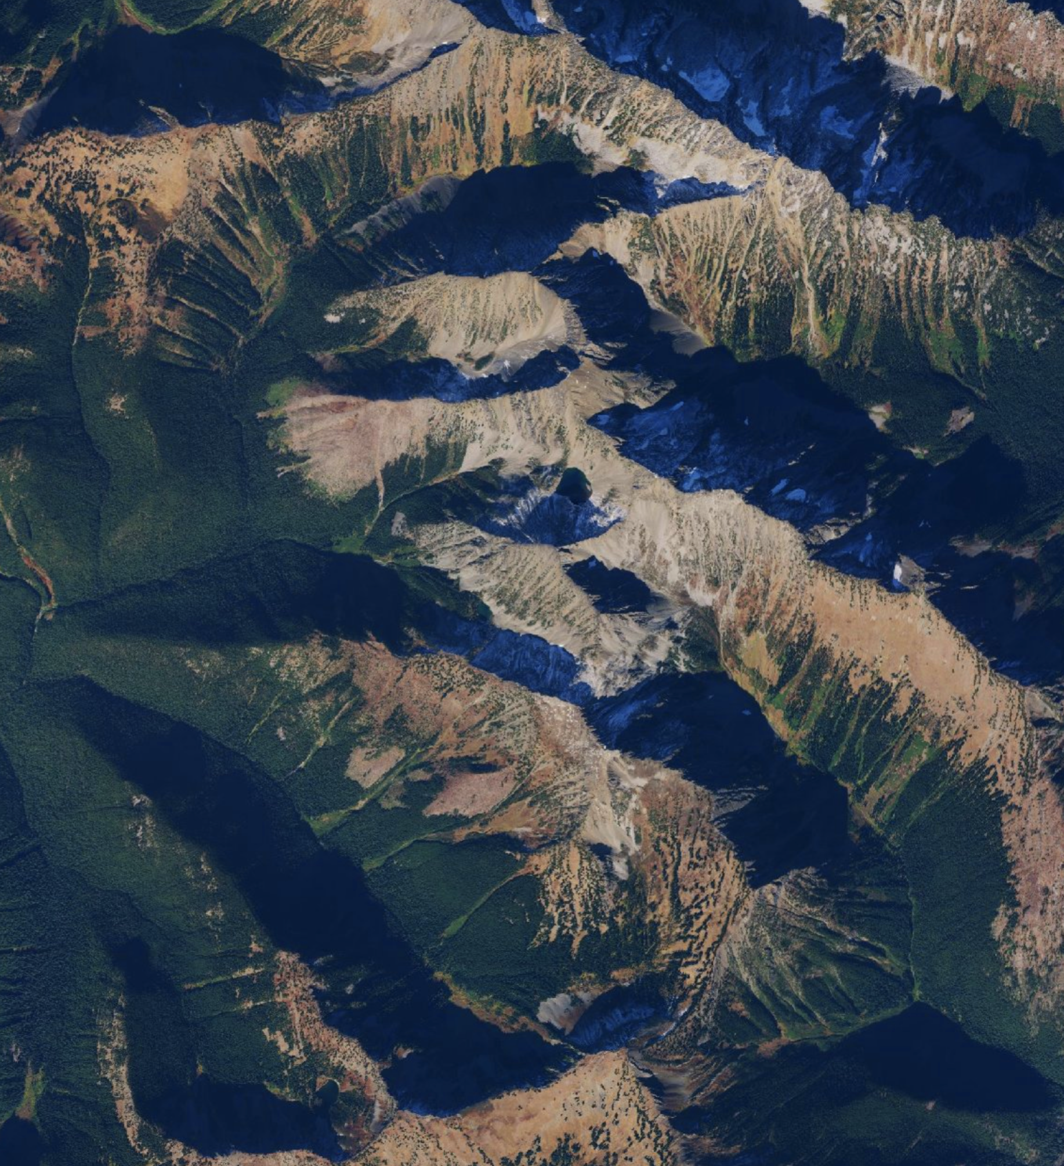
NAIP Imagery
- High resolution 60cm to 1m by USDA
- 2011 to 2018 in public S3 bucket
- 3 year repeat cycle
- Future work: 4-band RGB+NIR now in COG
https://github.com/kylebarron/naip-cogeo-mosaic
Live demo: https://kylebarron.dev/naip-cogeo-mosaic

Slide 6
NAIP Imagery
NAIP imagery overlaid on terrain mesh

Slide 7
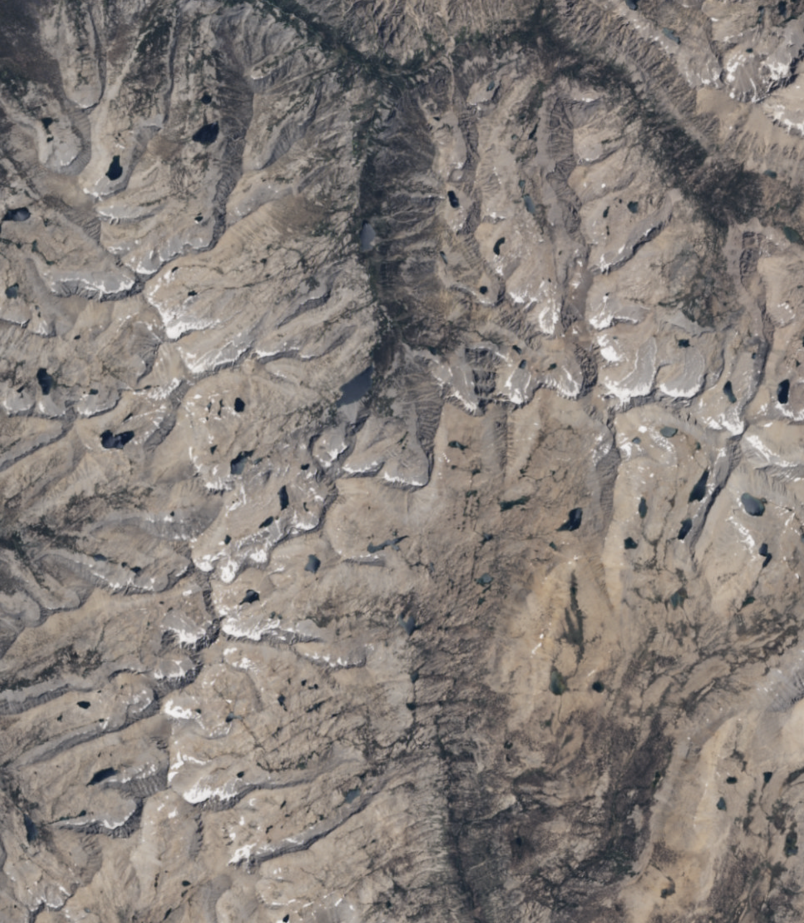
Landsat 8
Global imagery since 2013, 16 day repeat cycle
30-meter spectral resolution
Landsat Collection 2 coming in 2020; COG for all data since 1972
https://github.com/kylebarron/landsat8.earth (Website)
https://github.com/kylebarron/landsat-cogeo-mosaic (Mosaic creation)
https://github.com/kylebarron/landsat-mosaic-tiler (Serverless tiler)
Live demo: https://landsat8.earth

Slide 8
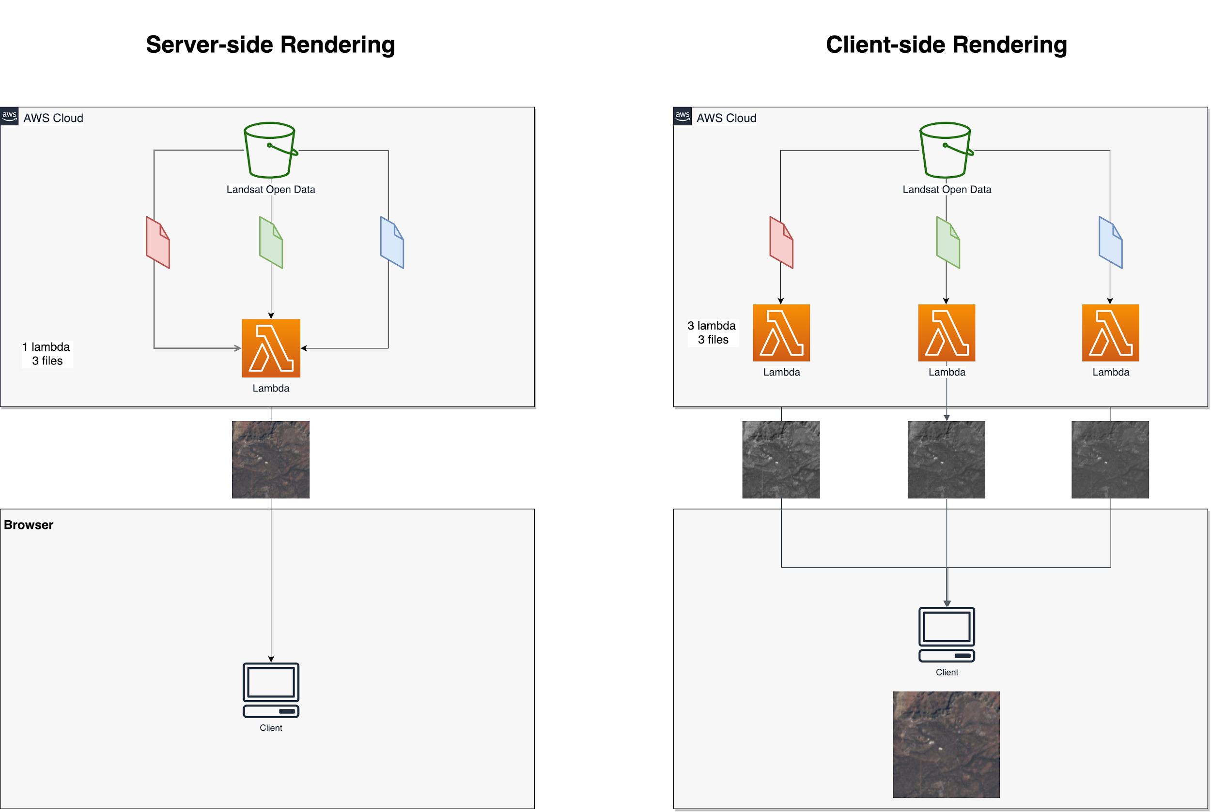
Parallel requests
Notes:
Architecture
How landsat works and why it’s special, something that hasn’t been done before

Slide 9
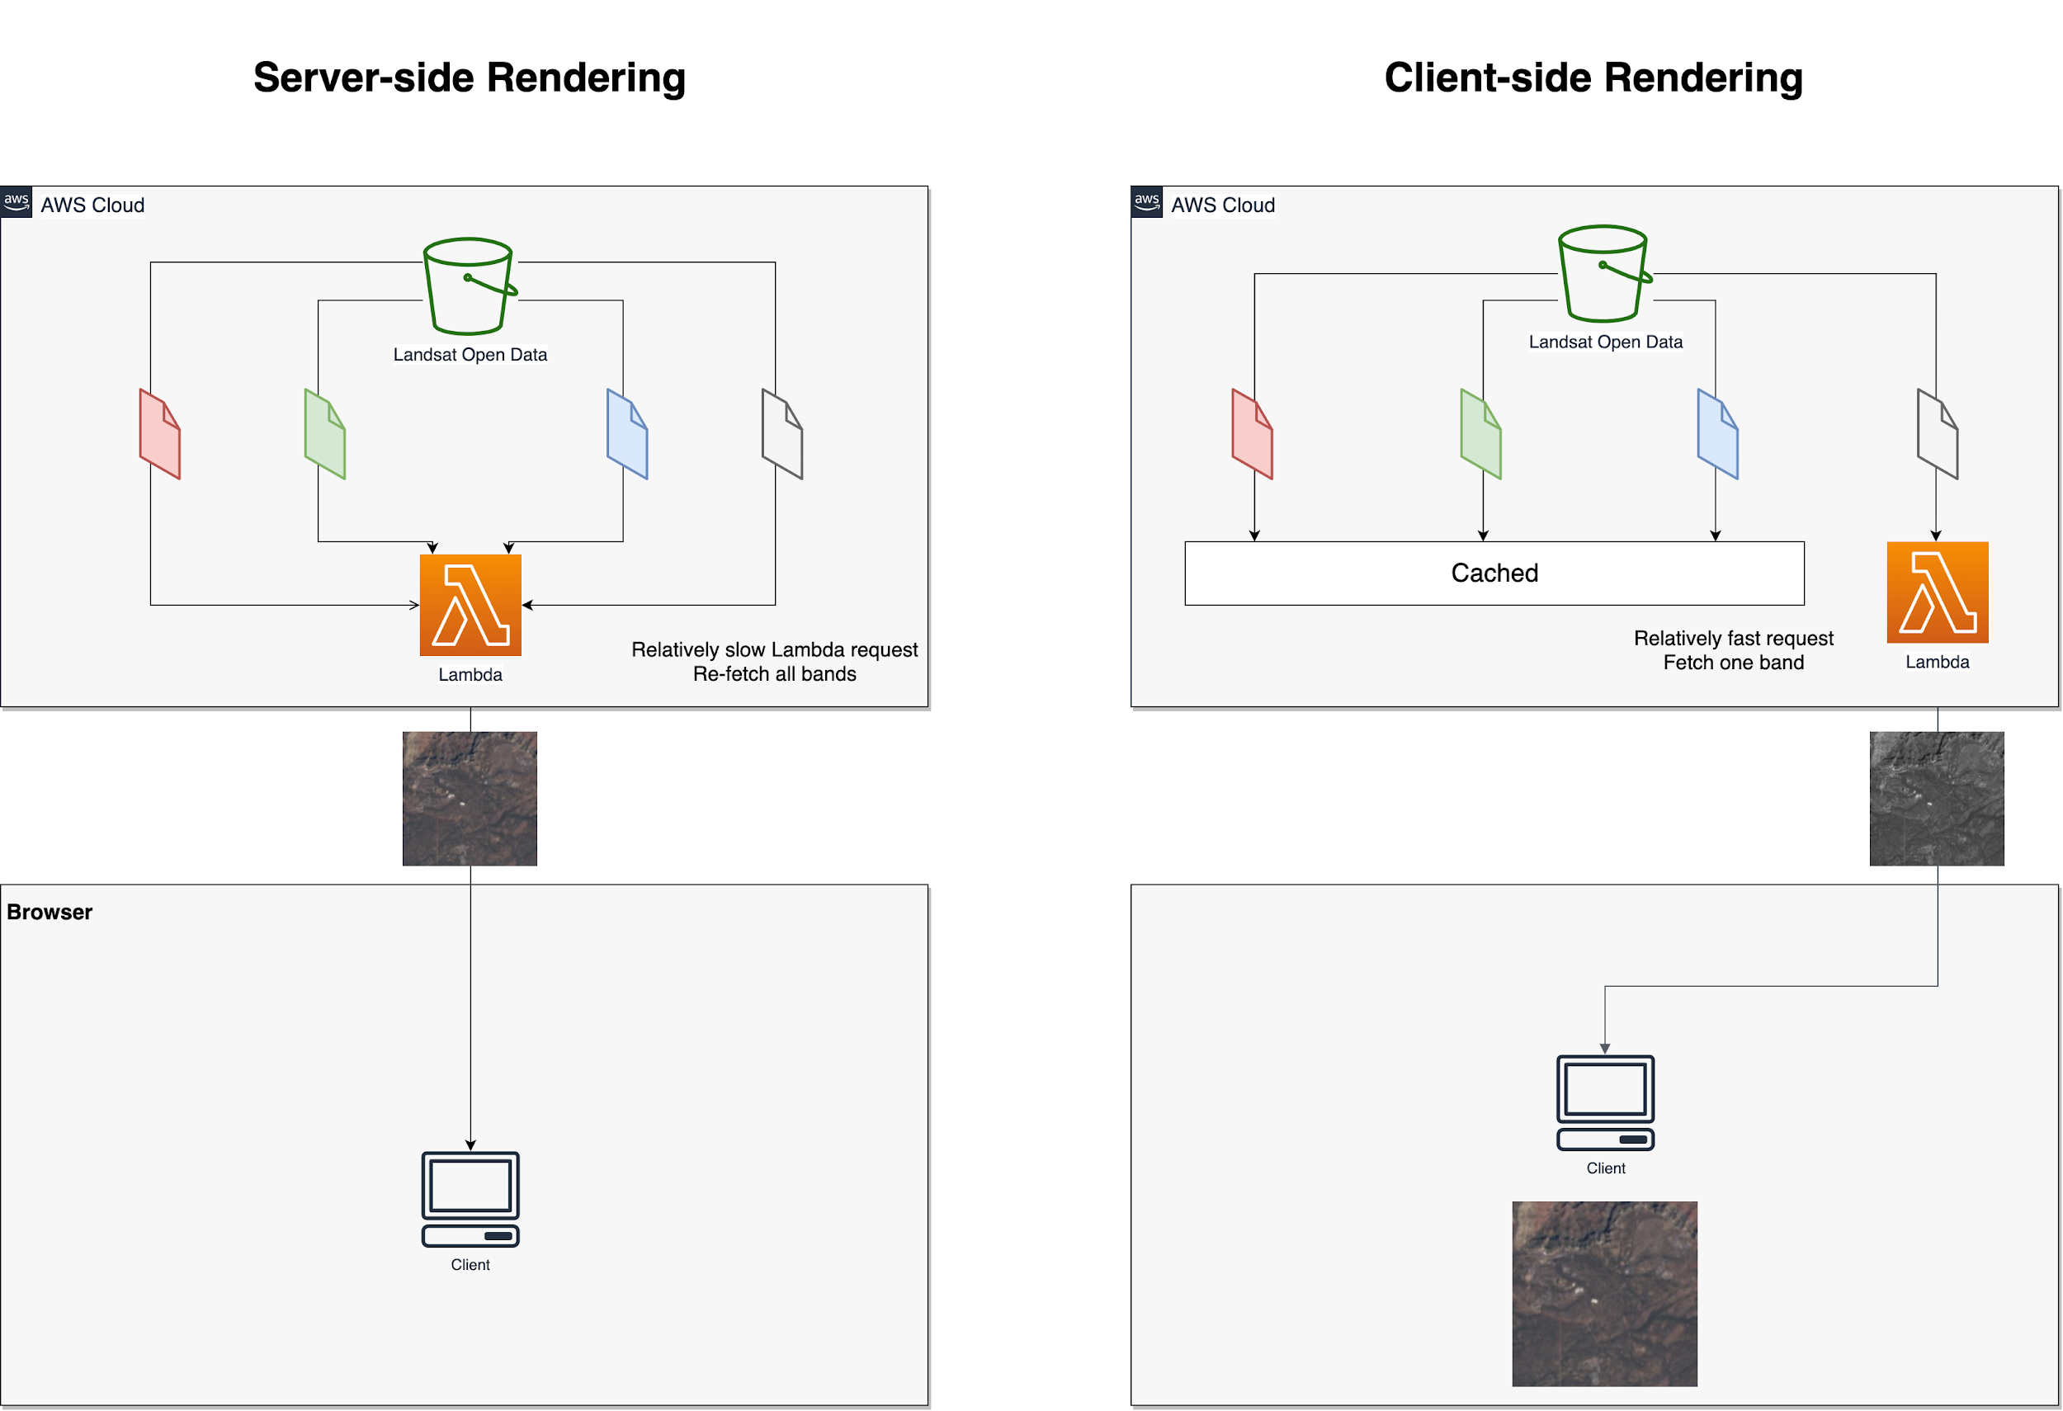
Additional image band

Slide 10
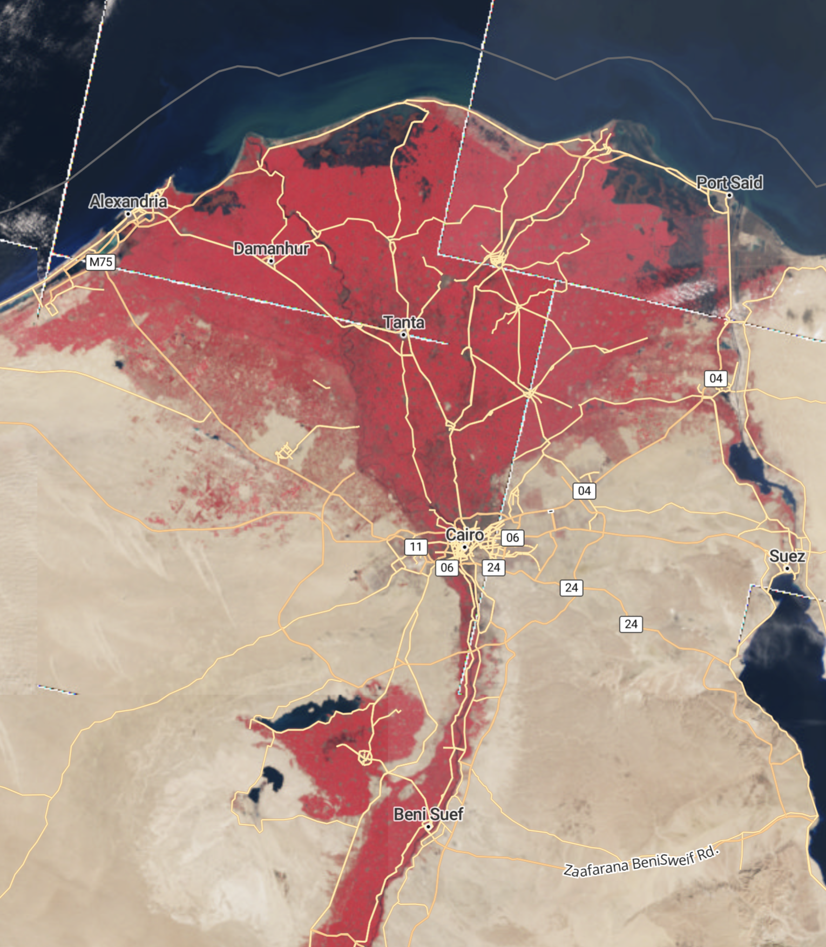
Landsat: False Color
Any band combination possible client-side
Server request only needed for new bands
False-color Infrared of the Nile River Delta from https://landsat8.earth

Slide 11
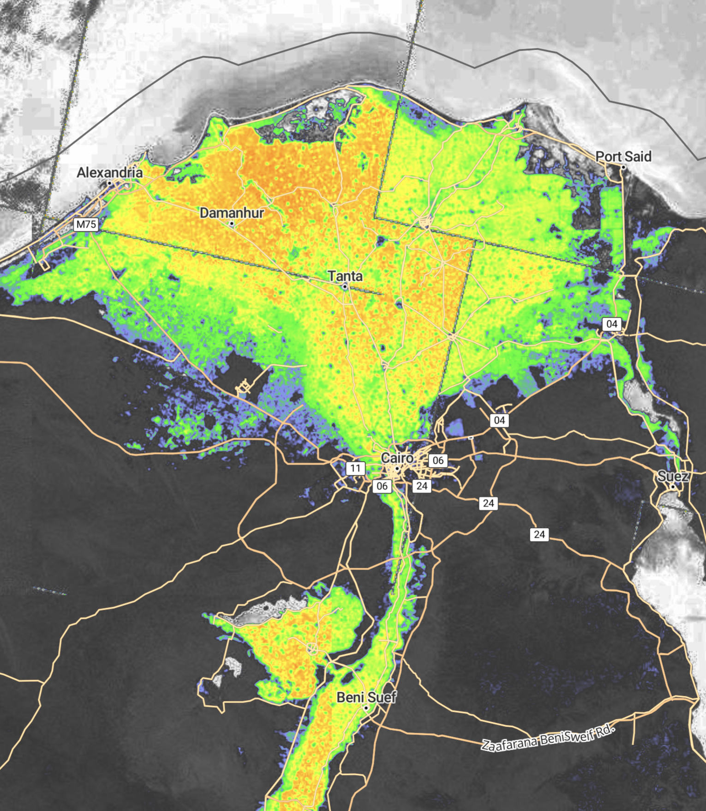
Landsat: Spectral Index
Spectral indices computed client side
Vegetation Indices (NDVI, EVI, etc)
Moisture Index (NDMI)
Burn index (NBR)
Extensible for new algorithms
Apply colormap on GPU: no server round trip
https://github.com/kylebarron/deck.gl-raster (client-side raster processing)
NDVI of the Nile River Delta from https://landsat8.earth

Slide 12
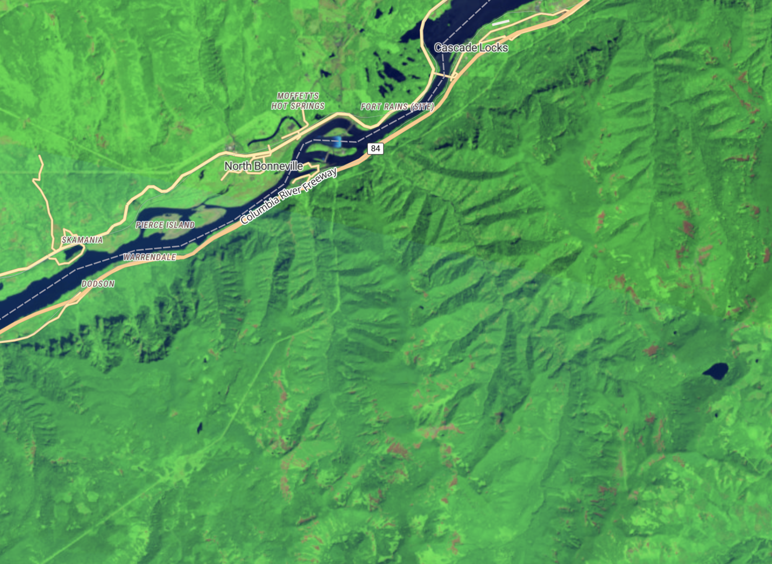
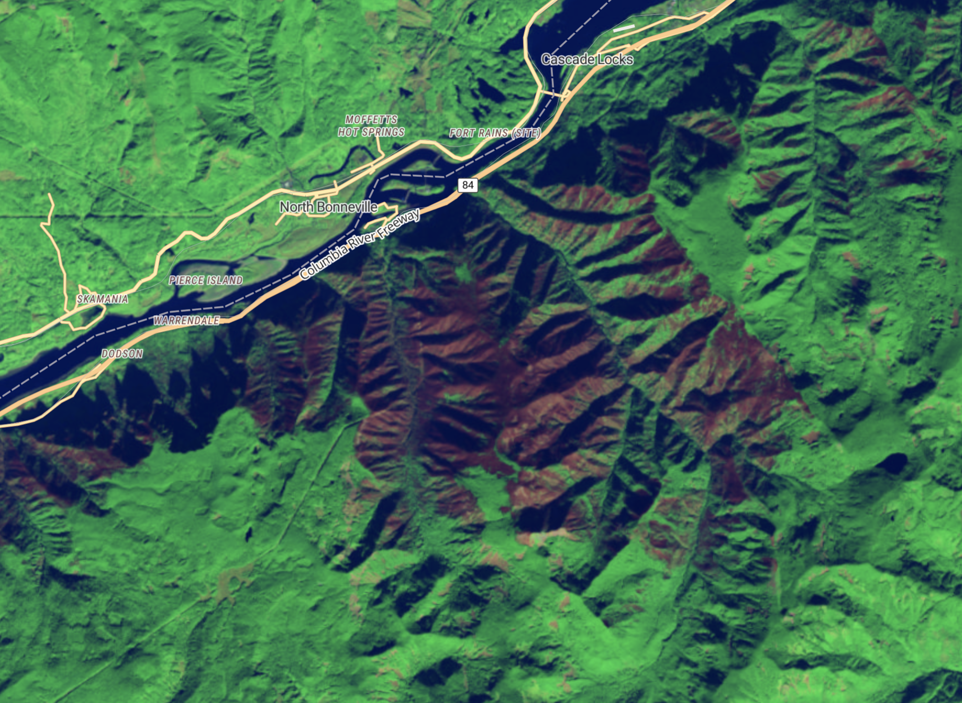
Landsat: Image Flexibility
No pregenerated data = flexibility in image selection
Eagle Creek Fire, Late-summer 2017
Landsat False-Color Forest Burn: Summer 2017
Landsat False-Color Forest Burn: Fall 2017
Notes:
Eagle Creek Fire

Slide 13
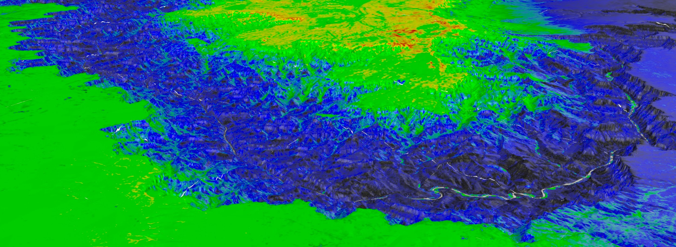
Landsat: Terrain + Spectral Index
3D Landsat NDVI of the Grand Canyon

Slide 14
Why these projects?
Unemployed: learning skills
How to cheaply get experience?
Compute on satellite data = $$$
Public access to COGs democratizes access
All demos fully self-hosted
Notes:
At this point, I’ve explained the what and the how, but not the why.
Client = offload compute

Slide 15
Advice for COG + Mosaics
Notes:
Things to know for your own projects with COG

Slide 16
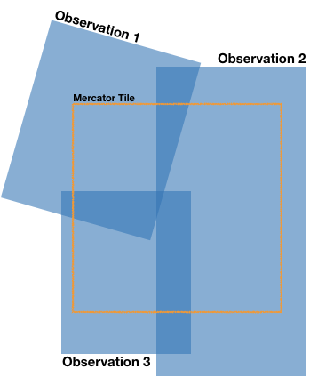
Image Selection
MosaicJSON: spatial index defining source images for mercator tile
- NAIP, Elevation: Easy: non-overlapping, cloudless images
- Landsat: Hard: cloud cover, seasonality, not aligned with Web Mercator grid, overlap between images
- Historical Maps: Hard: overlapping resolutions/scales; temporal variation
https://github.com/developmentseed/mosaicjson-spec
COG Talk -- Mosaics: https://medium.com/devseed/cog-talk-part-2-mosaics-bbbf474e66df
Image Credit: Vincent Sarago

Slide 17
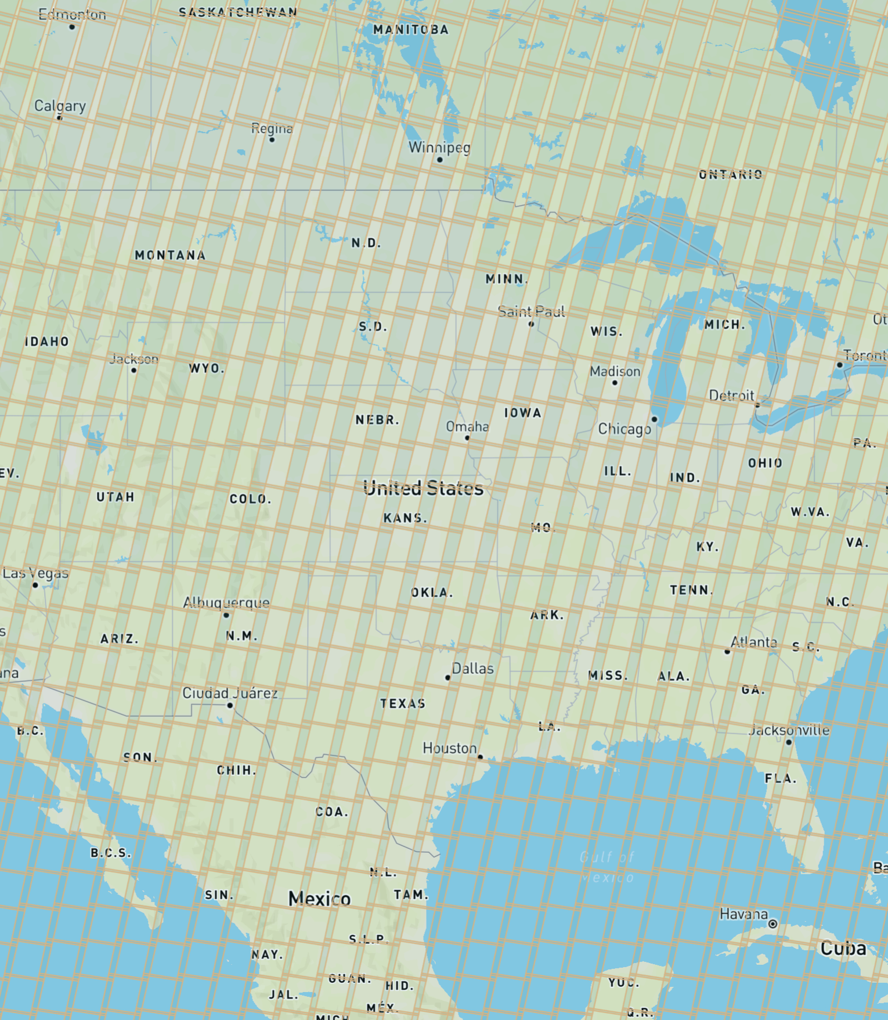
Performance
Mosaic composition
Parallelize bands; client-side image manipulation
Locate server near data (same AWS region)
256-pixel image tiles
Caching
Bigger server
Average Latency: 250ms (terrain mesh) to 1s (Landsat)
Landsat scene grid

Slide 18
Pricing
Reinforces focus on performance: faster responses = less cost
USGS Topo: ~$30/million requests
NAIP: ~$30/million requests
Landsat: $25/million requests (per band)
Terrain mesh: ~$12/million (from Terrain Tiles)
Possible to decrease further with caching

Slide 19
Thanks!
Possible because of USGS, USDA, AWS, and others!
References:
https://www.cogeo.org/
COG Talk (Vincent Sarago): https://medium.com/devseed/cog-talk-part-1-whats-new-941facbcd3d1
Blog: https://kylebarron.dev/blog (more posts in progress)
Twitter: @kylebarron2
Notes:
COG enables democratization of satellite data

